Slide 1

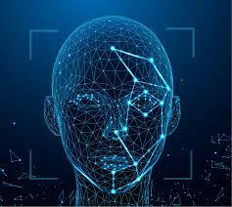
ISM 6900 IMAGE MINING Facial Recognition
Done by-
Sheetal Murali

Slide 2

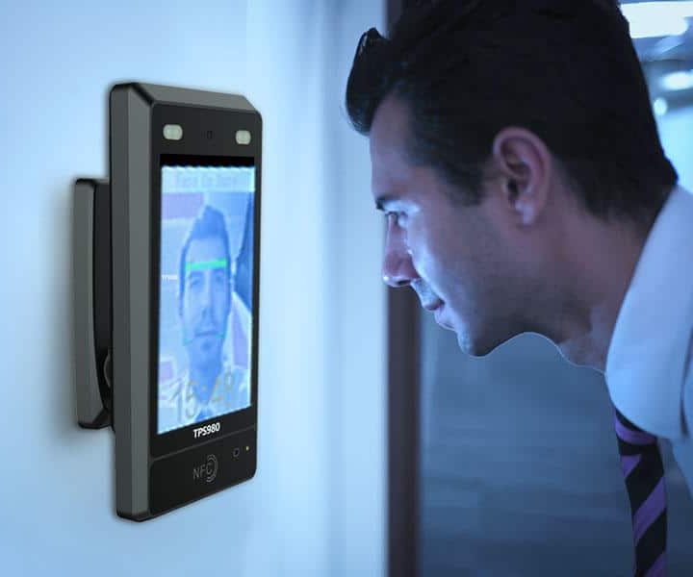

INTRODUCTION FACIAL RECOGNITION
Recognize human faces in images or videos, determine whether the face in two images belongs to the same person, or search for a face in a big collection of existing images.
validate identification
Recognizes and measures facial traits in images
Used in biometric security, smartphones, onboarding or logins, etc

Slide 3
AMAZON REKOGNITION
Service by Amazon Web Services where we can add image analysis to any application.
If we provide an image or video to the Amazon Rekognition API, the service can detect, analyze, and compare faces
I have built my own face recognition service by combining the capabilities of Amazon Rekognition with other AWS services like Amazon DynamoDB, Lambda and S3 Bucket.

Slide 4

INFRASTRUCTURE
Amazon Rekognition
DynomoDB
Lambda Function
Amazon S3 bucket

Slide 5
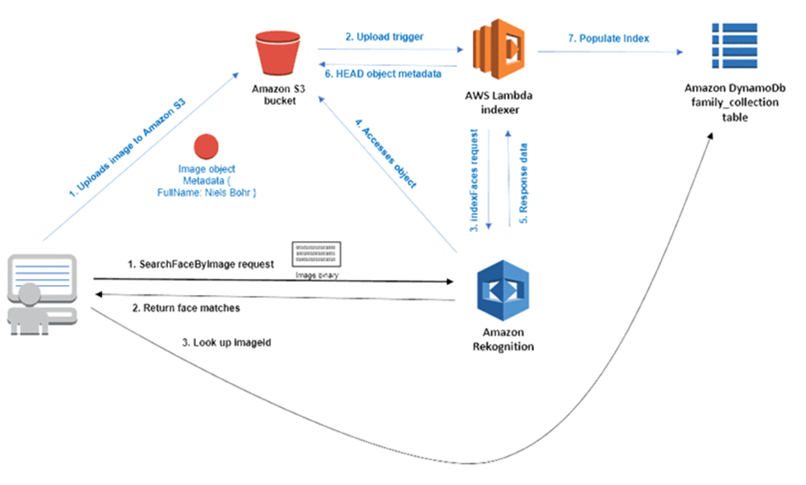
PROCESS
INDEXING – Blue flow
ANALYSIS – Black Flow

Slide 6

Demo AWS

Slide 7
3 W’s
What went well?
Was able to explore AWS which was a completely new tool for me.
The Book reading helped me with the theoretical concepts behind Faceprint and how image vectors are formed.
AWS has excellent documentation which helped in understanding the concepts.
2) What did not go well?
Setting up the infrastructure consumes a lot of time because understanding the technical terms used in AWS requires a deep dive into the documentation which was a little confusing.
Tried to use Emotions API but this required a paid subscription of AWS
3) What would I do differently next time?
Currently I’m using solo pictures, next time I would use a group picture and use extract API
Use secondary match logic: Currently Amazon Recognition gives a confidence score for the images and the result is shown according to the highest confidence score. But using the secondary match logic, we can predict fuzzy images by returning a probability of who the person could be.

Slide 8

Thank You!

